Slide 1


I/O PROCESSOR DESIGN OF MICRO RISC ISA PROCESSOR FOR IOT APPLICATION
GUIDED BY:
Er.SAJ KAPOOR
Senior Director of Engineering,
Analog Devices,Bangalore
PRESENTED BY:
ANAMIKA CHITHRAN(B18ECA17)
CHETHAN KRISHNA(B18ECA27)
S SANKARA SUBRAMANIAN(B18ECA60)
SUSMITH DAS K K(B18ECA62)
PROF RESHNA S
Associate Professor
Dept.of ECE
TKM COLLEGE OF ENGINEERING
Kollam

Slide 2
CONTENTS
Introduction
Literature Survey
Objective
Methodology
Results
Future scope
Conclusion
References

Slide 3
INTRODUCTION
To design a DMA controller and memory controller for 16 bit fixed and floating point processor core derived from existing SHARC based ADSP-2106x processor.
ADSP-2106x is a RISC based microprocessor developed by Analog Devices mainly used for DSP applications.
DMA provides a mechanism for transferring an entire block of data between memories and devices with least inputs from CPU .
Memory controller for interfacing external memory.

Slide 4
LITERATURE SURVEY
S. Min, M. Alian, W. -M. Hwu and N. S. Kim, "Semi-Coherent DMA: An Alternative I/O Coherency Management for Embedded Systems," in IEEE Computer Architecture Letters, vol. 17, no. 2, pp. 221-224, 1 July-Dec. 2018, doi: 10.1109/LCA.2018.2866568.
  Modern embedded CPUs adopt NC-DMA over C-DMA because of simplicity
  NC-DMA design - device driver flush a wide range of cache space
  SC-DMA can solve excessive invalidation problem
  Small DMA cache record recent DMA buffer regions
  DMA mapping - SC-DMA marks and invalidates the DMA region
  Marks are merged as a 64-bit mask and stored in the DMA cache
  Proposed model improved the Rx bandwidth of a 10GbE NIC by up to 54%

Slide 5
N. Vujic, F. Cabarcas, M. Gonzalez Tallada, A. Ramirez, X. Martorell and E. Ayguade, "DMA++: On the Fly Data Realignment for On-Chip Memories," in IEEE Transactions on Computers, vol. 61, no. 2, pp. 237-250, Feb. 2012, doi: 10.1109/TC.2010.255.
  Single-Instruction Multiple-Data (SIMD) units found in a variety of processors.
  Their efficiency are usually bounded by alignment of memory architecture.
  DMA++ engine is enriched with a Realignment Unit.
  The DMA++ engine consists of a DMAC, BIU ,RU.
  Realignment Unit that performs parallel to DMA engine.
  Reorder Buffer (ROB), Two-entry buffer, Block Decrementers, Realignment Networks, and Merge Networks.
  Realignment Network consists of a shift count register, Barrel shifter.

Slide 6
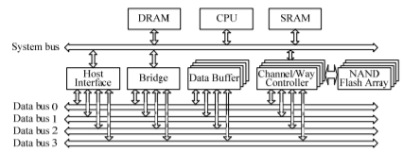
3) H. Jung, S. Jung and Y. H. Song, "Architecture exploration of flash memory storage controller through a cycle accurate profiling," in IEEE Transactions on Consumer Electronics, vol. 57, no. 4, pp. 1756-1764, November 2011, doi: 10.1109/TCE.2011.6131151.
  NAND flash memory a storage medium in devices such as mobile phones, MP3 players, and digital cameras
  SSDs have an inherent weakness stemming from NAND flash memory and its complex architecture
  If the data in a page are updated,even by one bit, the entire block that the page belongs to must be erased
  Limited write/erase cycle for SSD’S.Beyond this it can’t be used for storage
  Architecture of SSD Simulator-CPU,SRAM/DRAM,Data Buffer,Host interface,Channel/way controller.
Fig.1 Architecture of SSD simulator

Slide 7
Read Request Handling
When a read request arrives, an interrupt is sent from the host interface to the CPU as a notification of the event
The CPU then starts to run the IRQ handler . This handler reads request information from the host interface and inserts it into the request queue
The FTL then loads the new request from the queue.
The command packet is sent to the channel/way controller and generate number of pages in the request
Once the way buffer is filled with data, the channel/way controller performs a backend DMA operation to move data to the data buffer .
When data are stored in the data buffer, the FTL checks whether or not the request has been completed successfully
If successful, the host interface trashes data from the data buffer and the request information is removed from the request queue.

Slide 8
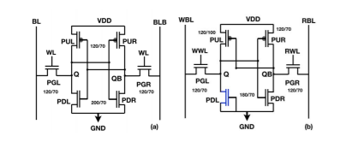
N. Surana and J. Mekie, "Energy Efficient Single-Ended 6-T SRAM for Multimedia Applications," in IEEE Transactions on Circuits and Systems II: Express Briefs, vol. 66, no. 6, pp. 1023-1027, June 2019, doi: 10.1109/TCSII.2018.2869945.
  A single ended 6-T (SE6T) static random access memory (SRAM) cell is proposed.
  50% less dynamic power compared to conventional 6-T SRAM cell.
  Uses only single bit-line for write and single bit-line for read
Fig.2 conventional 6-T SRAM (b) proposed SE6T SRAM cell.

Slide 9
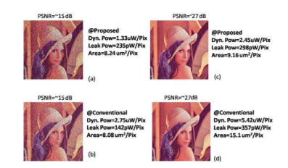
For a total BER of 0.05% at operating voltage of 0.55-0.65V, the 6T SRAM cell takes 2.34 µm2, whereas SE6T SRAM cell takes 1.2 µm2 as only one transistor (PGL) needs to be sized
Power Consumption-
For PNSR of 15 dB, the proposed SE6T memory consumes only 0.48× dynamic power as compared to conventional 6-T SRAM cell with barely 2% additional area.
For PSNR of 27dB,proposed SE6T based memory is highly energy efficient and consumes 0.45× dynamic power, 0.83× leakage power and takes 0.6× area when compared to conventional 6-T SRAM cell based embedded memory
Fig.3 Dynamic power, leakage power and area required per pixel

Slide 10
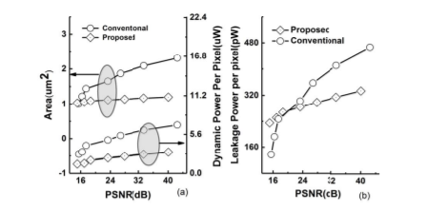
Except for low PSNR value, SE6T embedded memory needs lesser area, and has lower leakage and dynamic power compared to conventional 6-T SRAM cell based memory.
Fig.4 (a) Dynamic power and area consumed per pixel versus obtained PSNR (b) Leakage power consumed per pixel versus obtained PSNR.

Slide 11
H. Kavianipour, S. Muschter and C. Bohm, "High performance FPGA-based DMA interface for PCIe," 2012 18th IEEE-NPSS Real Time Conference, 2012, pp. 1-3, doi: 10.1109/RTC.2012.6418352.
  Data communication suit
  Developed for use in the Track Engine Trigger for IceCube Neutrino Observatory at South Pole.
  Applicable to bidirectional DMA transfer between FGPA logic and system memory on host PC via PCIe.
  Suit contains a DMA controller firmware, test benches, a Linux driver and
a user application for DMA.

Slide 12
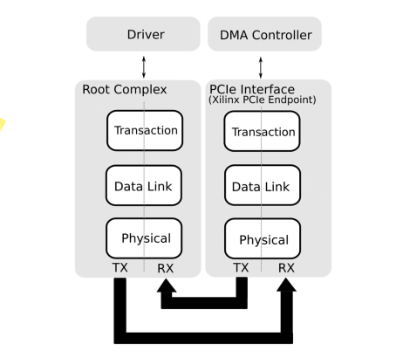
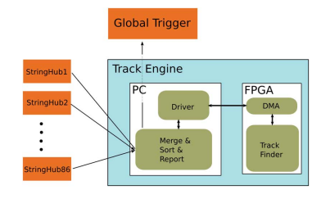
Fig. 5. Track Engine hierarchy.
Fig. 6. Communication between the driver and the DMA Controller over the PCIe hierarchy.

Slide 13
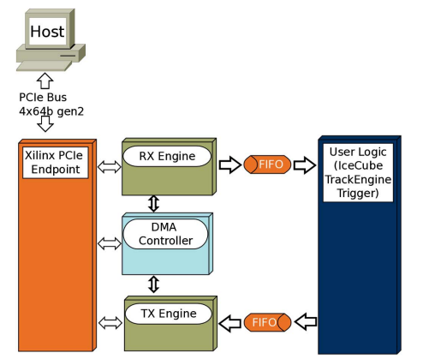
Fig. 7. DMA controller supervises the data transfer between the user logic and PCIe Endpoint.

Slide 14
L. Rota, M. Caselle, S. Chilingaryan, A. Kopmann and M. Weber, "A PCIe DMA Architecture for Multi-Gigabyte Per Second Data Transmission," in IEEE Transactions on Nuclear Science, vol. 62, no. 3, pp. 972-976, June 2015, doi: 10.1109/TNS.2015.2426877.
  A direct memory access (DMA) engine compatible with the Xilinx PCI Express (PCIe) core to provide a high-performance.
  To maximize the PCIe throughput the DMA address list is stored inside the FPGA and not in the central memory of the host CPU.
  The FPGA design package is complemented with simple register access to control the DMA engine by a Linux driver.
  A data throughput of 3461 MBytes/s has been achieved with a single PCIe Gen2 x8 lanes endpoint.

Slide 15
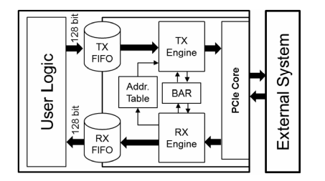
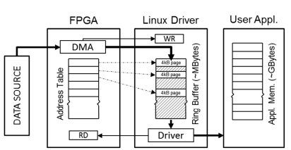
Fig. 8. Architecture of the DMA engine
Fig. 9. Memory organization

Slide 16
Mrinal J Sarmah, Bokka Abhiram , Anil kumar A “Method for Booting an All programmable System on-Chip over PCI Express Link”,2017 July IEEE
  Increased complexity of processors and peripherals
  Peripheral Component Interconnect Express
  Problem with flash devices
  PCI as a candidate for booting

Slide 17
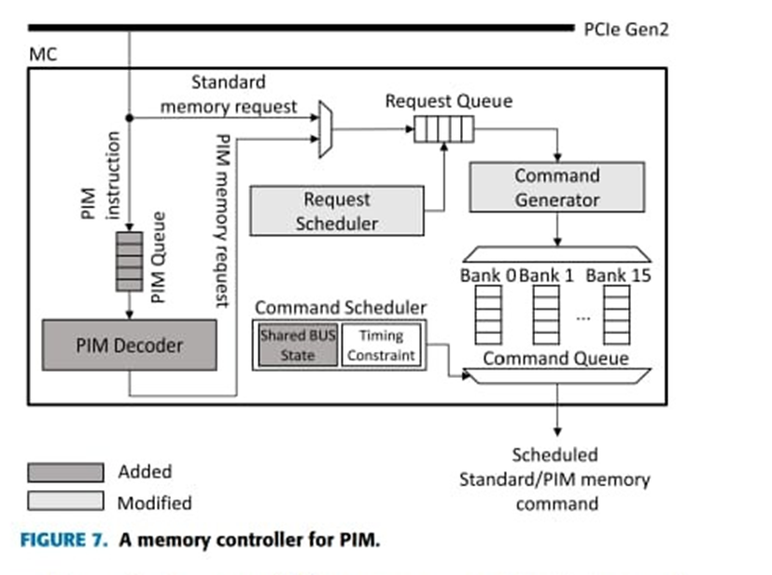
Design of Processing-‘‘Inside’’-Memory Optimized for DRAM Behaviors WON JUN LEE 1, CHANG HYUN KIM1, YOONAH PAIK1,June 2019
  To design and operate PIM Units inside DRAM
  Full computing performance and minimising the implementation cost
Fig.10 A memory controller for PIM

Slide 18
INFERENCES
18
Design of DMA controller and its architecture.
How to improve the dma transfer using different hardware elements.
Memory organization and architecture of SRAM and Flash memory .

Slide 19
OBJECTIVES
To design a DMA controller that can be configured to work in Chaining mode, Scatter-gather mode as well as in normal mode.
3-stage pipelining for improved throughput.
To design a memory controller that can be used for external memory access.
The core designed can work along with other subsystems to work as a processor for iot application.

Slide 20
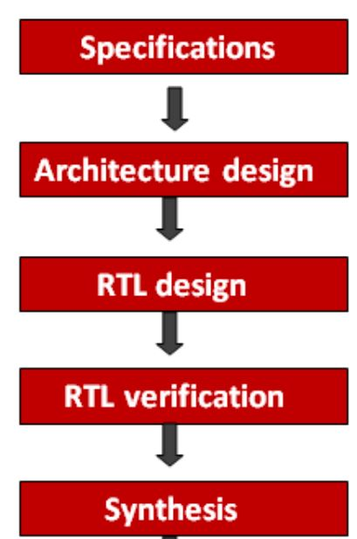
METHODOLOGY
Design Specification.
Architecture- ADSP-2106x
RTL design –Verilog
RTL verification – ModelSim and Python
Synthesis - Xilinx ISE design suite.
Fig 11: Block diagram of Design flow

Slide 21
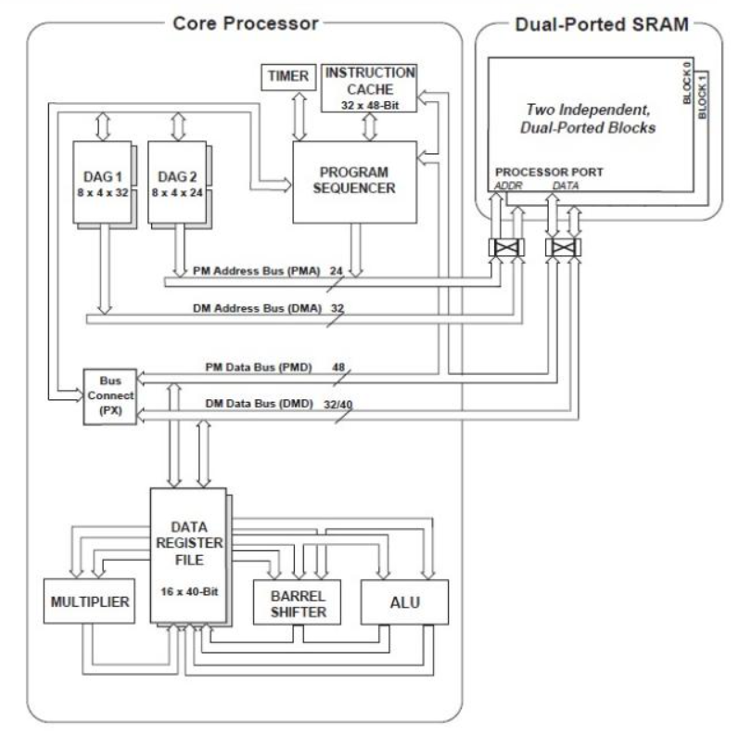
21
Block Diagram
Fig.12 Sharc ADSP-2106 core architecture

Slide 22
DMA controller
22
8 Depth FIFO for handling stalling
3 stage pipelined DMA Controller
Separate Internal and External Address Generators
Compatible to Interface with External memory of N+1 and N+2 read latency
Normal Mode, Scatter Gather mode , Chaining Mode.

Slide 23
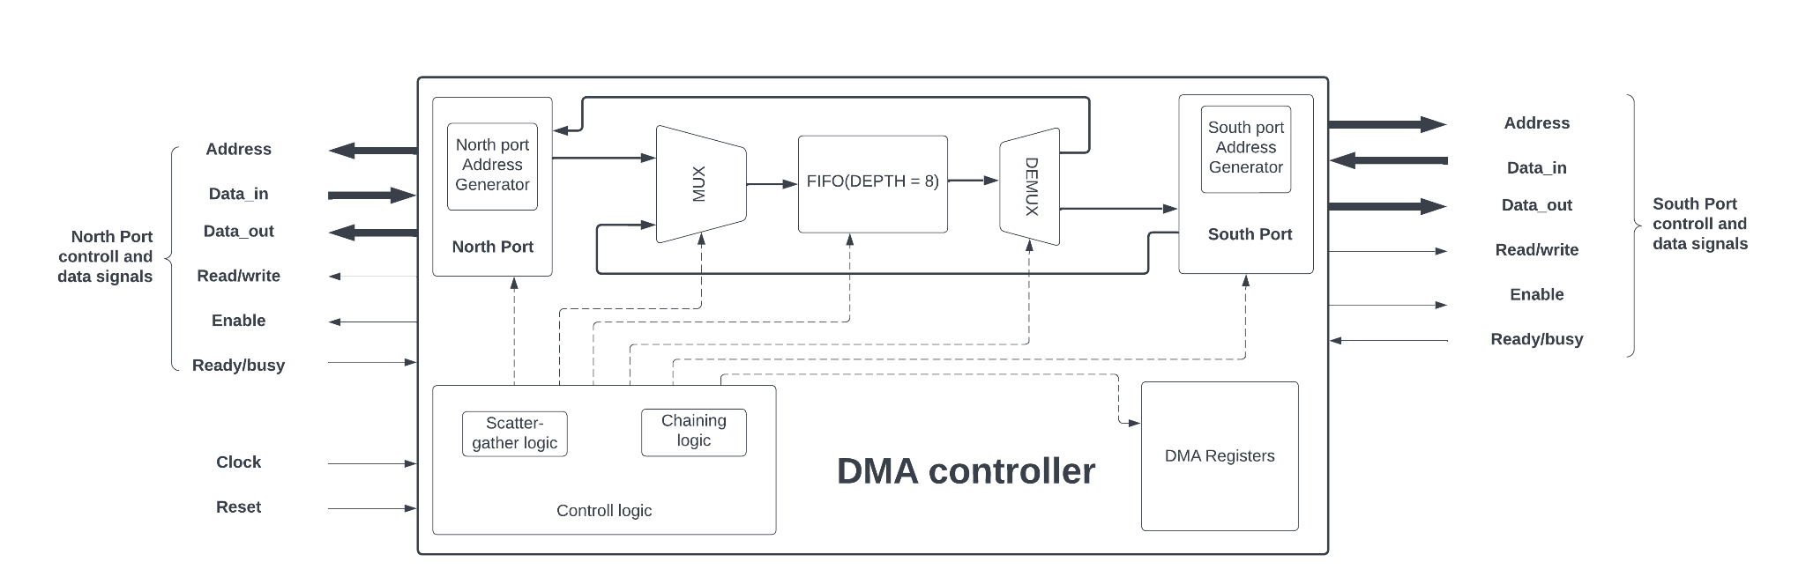
Fig 13: DMA Data & Control path

Slide 24
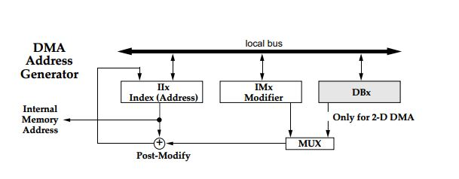
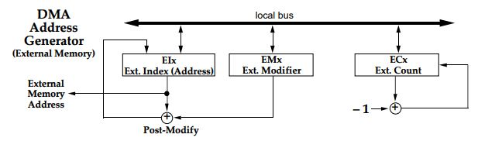
24
Fig 14: DMA Address Generator
Fig 15: DMA Address Generator (External Memory)

Slide 25
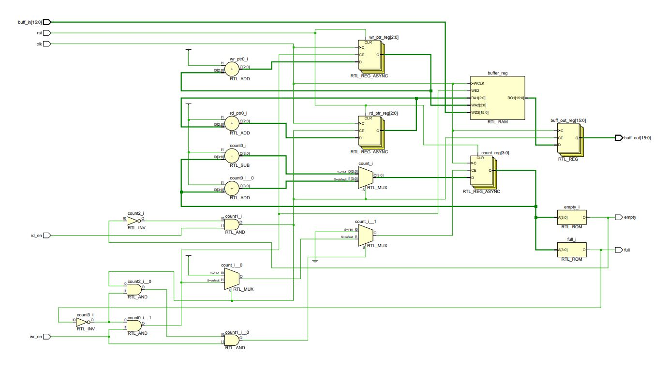
25
Fig 16: Synchronous FIFO

Slide 26
Pipelining
26
Internal memory access
External memory access
Fig.17- 3 stage Pipelining

Slide 27
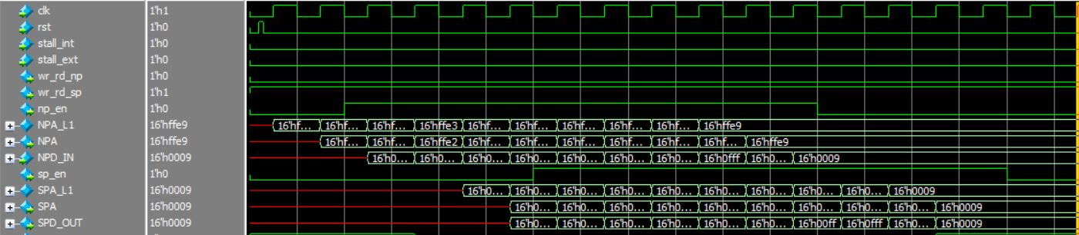
Internal to external memory data transfer
27
Fig.18 Internal to External Memory Data Transfer
Internal mem read: n^{th} cycle
External mem write: n^{th} cycle

Slide 28
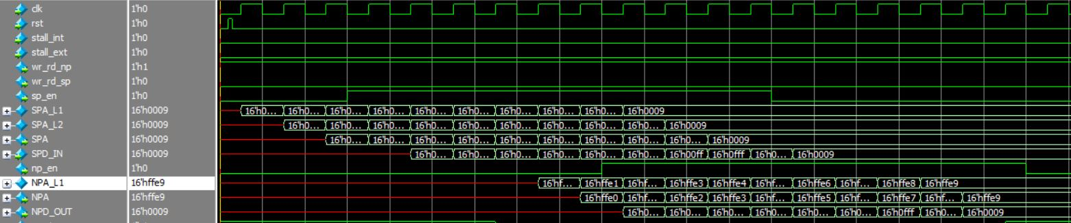
External to internal memory data transfer (n+1)
28
Fig.19 External Memory to Internal Data Transfer
External read: n+1 cycle
Internal write: n+1 cycle

Slide 29
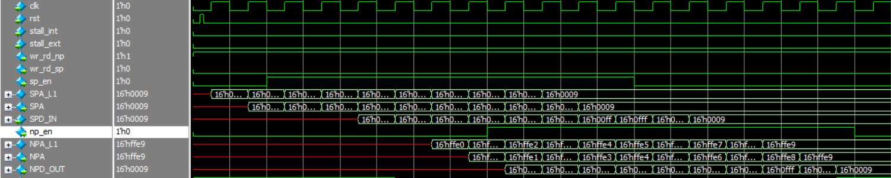
External to internal memory data transfer (n+2)
29
Fig.20 External to Internal Memory Data Transfer
External read: n+2 cycle
Internal write: n+1 cycle

Slide 30
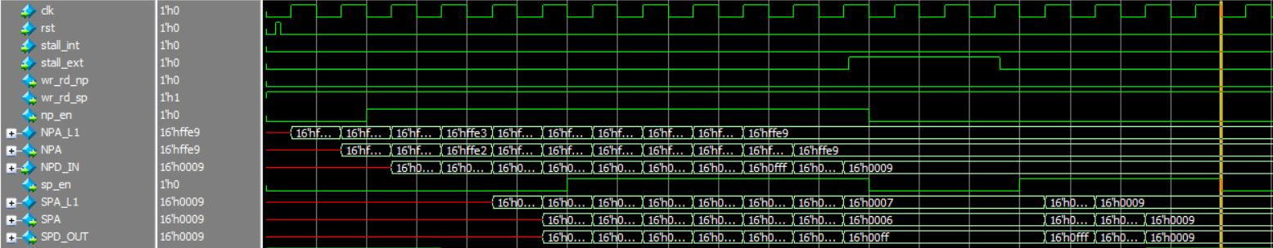
30
Fig.21 Stalling in pipelining

Slide 31
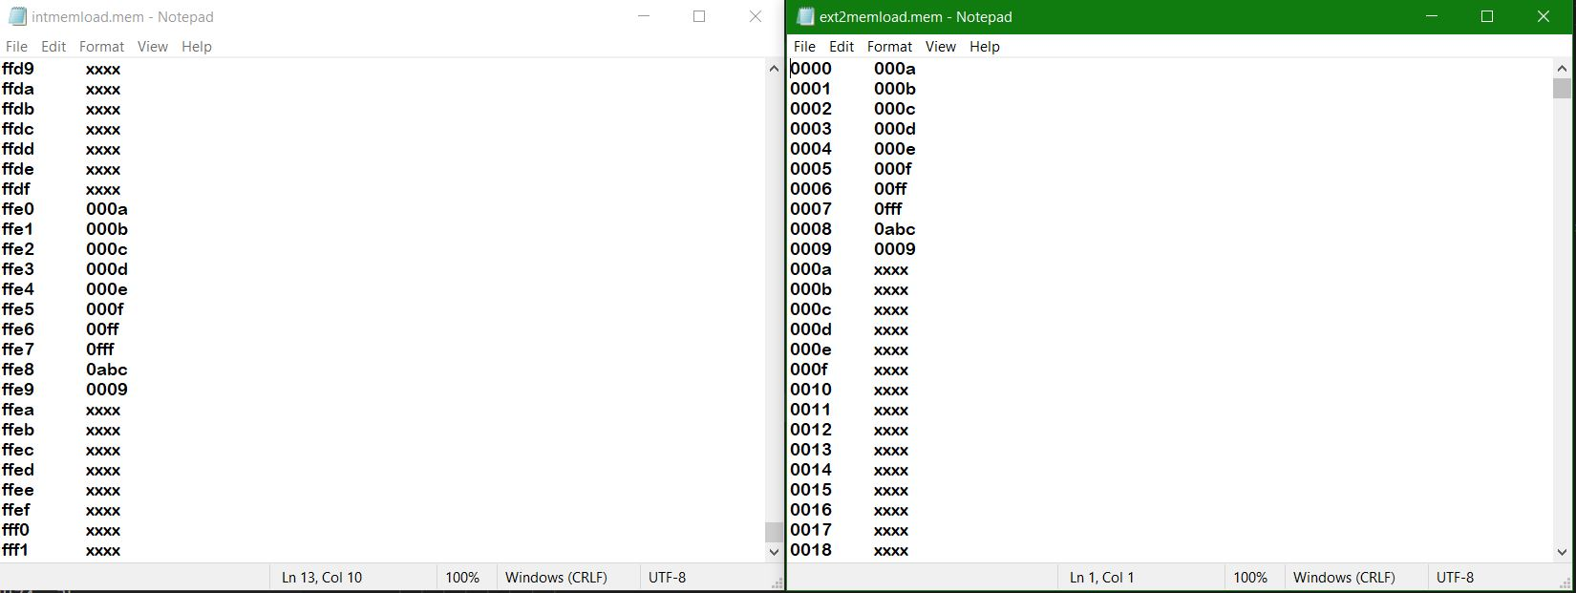
31
Fig.22 Memory contents

Slide 32
Scatter Gather DMA
32
DMA transfer of contiguous to non contiguous memory and vice-versa.
An FSM model is designed for supporting this complex data transfer.
Uses a portion of internal memory to store the non-contiguous memory locations.
Avoid Segmentation in memory.

Slide 33
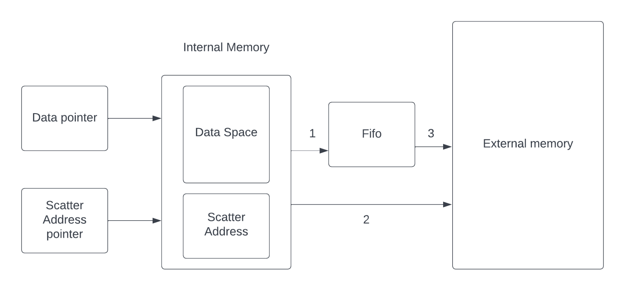
33
Fig.23 Scatter Gather Flow diagram

Slide 34
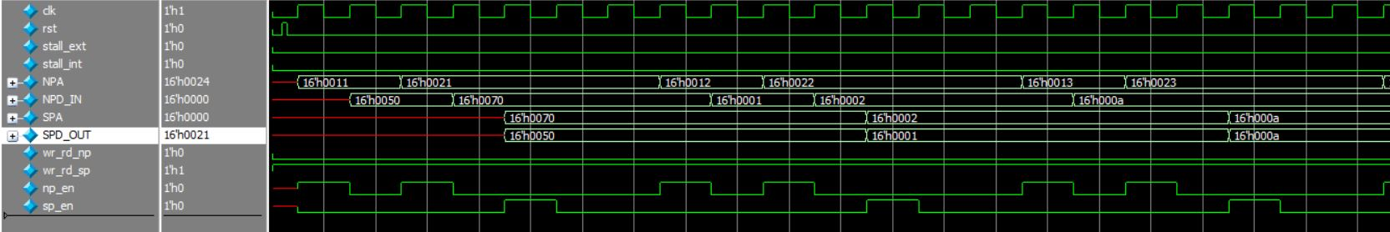
34
Fig.24 Scattering of data

Slide 35
Chaining Of DMA
35
DMA controller to auto initialize itself between multiple DMA transfers.
In chained DMA operation,automatically sets up another DMA transfer when the entire contents of the current buffer have been transmitted or received.
It uses CP register

Slide 36
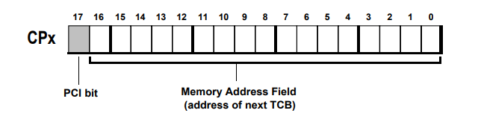
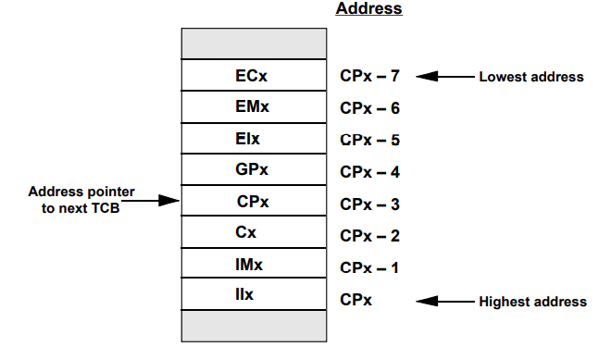
36
Fig 25: Chain Pointer Register & PCI Bit
Fig 26: TCB Setup In Memory

Slide 37
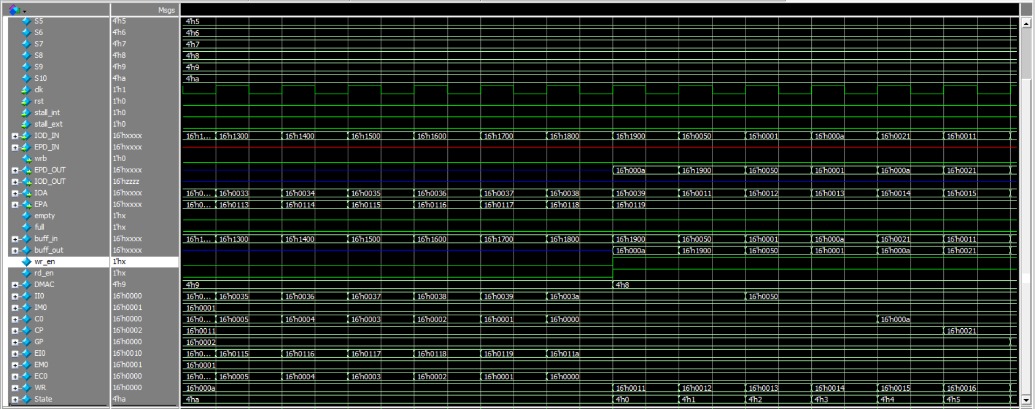
37
Fig 27: Timing diagram of Chaining of DMA.

Slide 38
Memory controller
38
Input signals - Address (16 bit)
- Data (16 bit)
- Ready(1 bit)
- Access Enable(1 bit)
- Clock
- Read Data from Memory(16 bit)
Output signals - Write Data to Memory(16 bit)
- Write Address to Memory (16 bit)
- Read Data from Memory (16 bit)
- Read Out (16 bit)

Slide 39
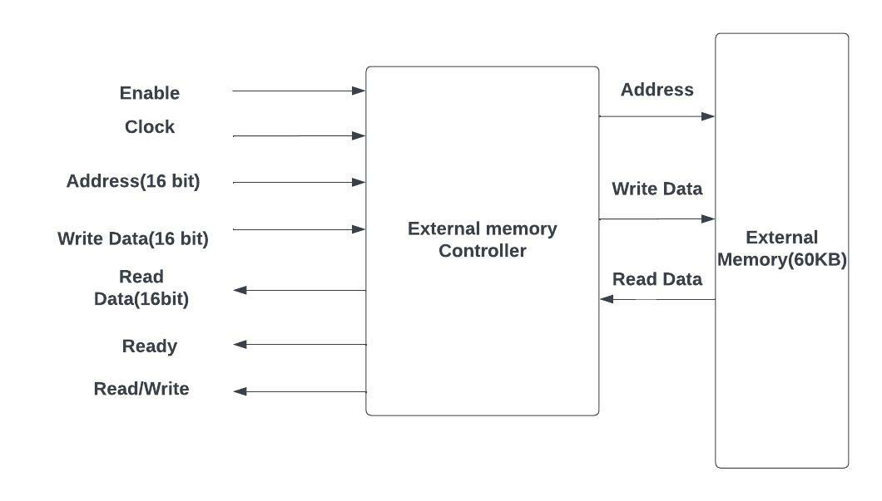
Block Diagram
39
Fig.28 Memory Controller

Slide 40
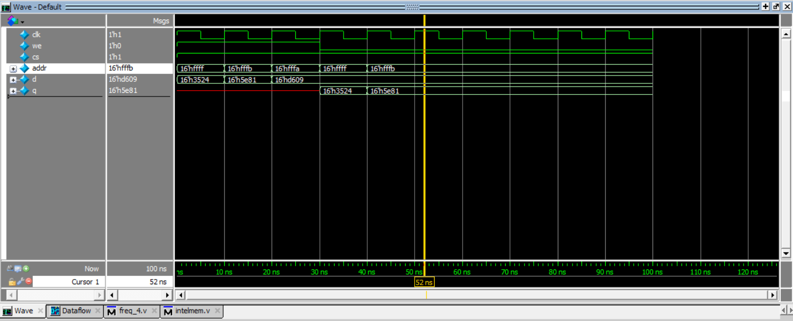
Write and Reading data to Memory
40
Fig.29 Testing of memory

Slide 41
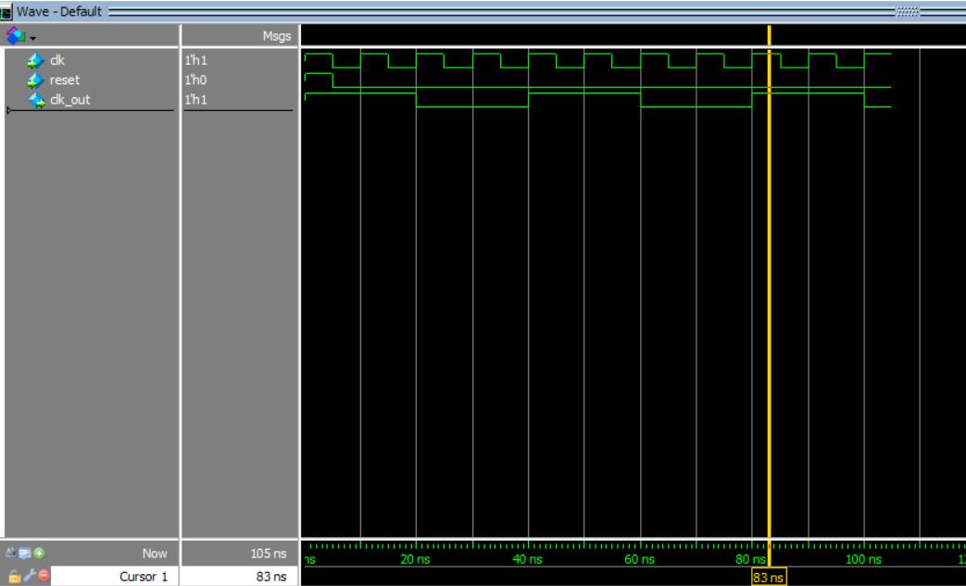
Testing Frequency Divider
41
Fig.30 Testing of Frequency Divider

Slide 42
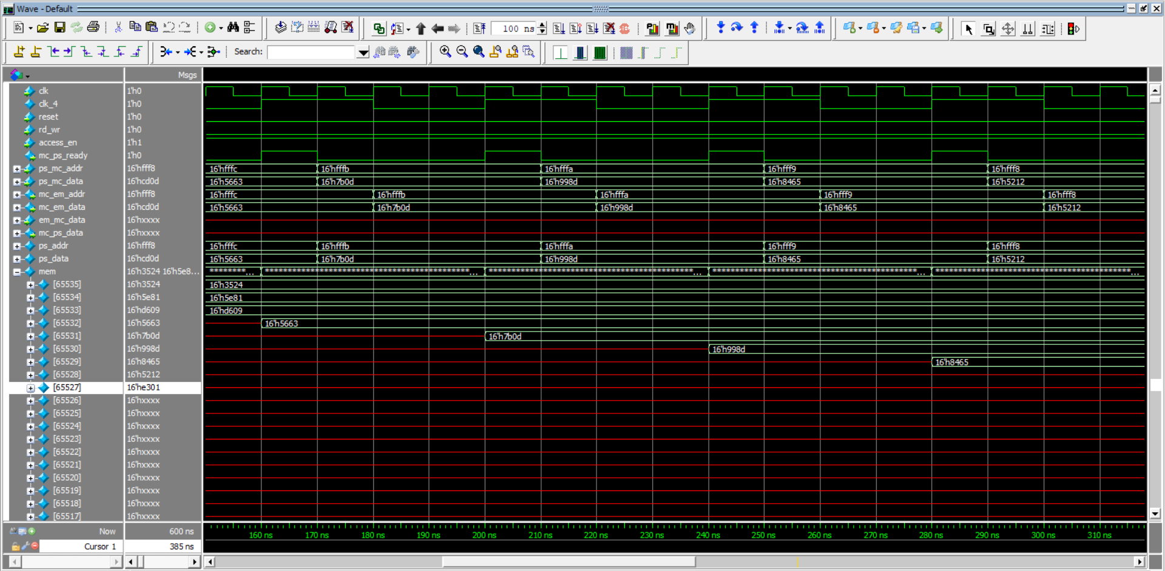
Memory Controller(Write Operation)
42
Fig.15 Testing of memory
Fig.31 Memory Contoller operation in write operation

Slide 43
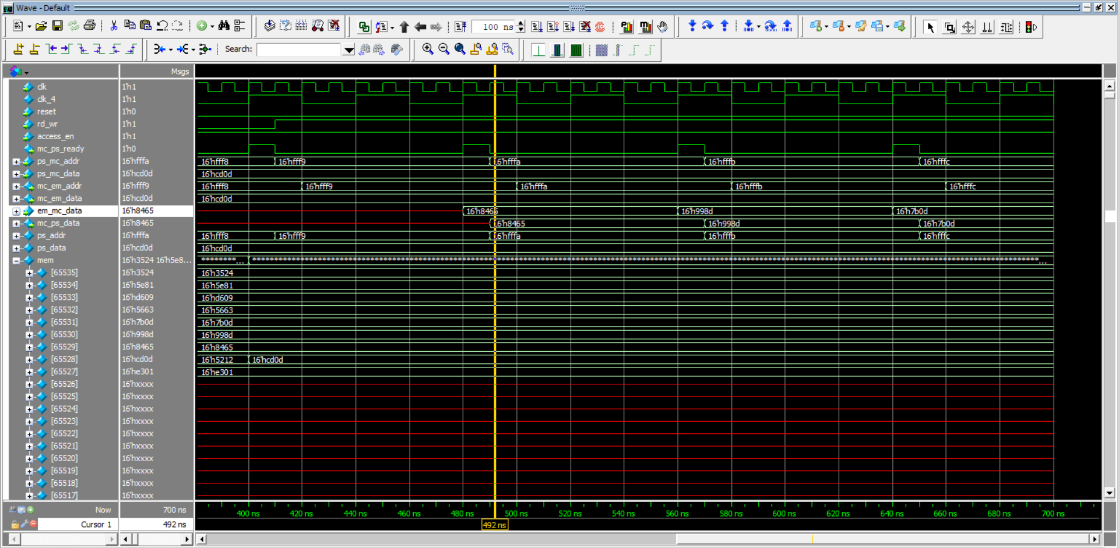
Memory Controller(Read Operation)
43
Fig.32 Memory Contoller operation in read operation

Slide 44
Future Scope
44
Serial Port and Link port can be implemented and integrated to already implemented blocks.
Bulk Data transfer in IoT applications.
Program loading into program memory during booting.

Slide 45
Results
45
Implemented different mode of implementation of DMA Controller
  Normal mode
  Chaining mode
  Scatter-Gather mode
Implemented the Memory control interface to handle read/write request from DMA and core processor

Slide 46
CONCLUSION
Scatter-Gather DMA is introduced to the existing dma architecture.
This DMAC can perform both contiguous and non – contiguous memory transfer.
Memory controller for external memory interfacing.
Core will support functioning of the Micro RISC ISA processor for iot application .

Slide 47
REFERENCES
[1] ADSP-2106x SHARC Processor User's Manual, Revision 2.1.
[2] H. Morales, C. Duran and E. Roa, "A Low-Area Direct Memory Access Controller Architecture for a RISC-V Based Low-Power Microcontroller," 2019 IEEE 10th Latin American Symposium on Circuits & Systems (LASCAS), 2019, pp. 97-100, doi: 10.1109/LASCAS.2019.8667579.
[3] S. Min, M. Alian, W. -M. Hwu and N. S. Kim, "Semi-Coherent DMA: An Alternative I/O Coherency Management for Embedded Systems," in IEEE Computer Architecture Letters, vol. 17, no. 2, pp. 221-224, 1 July-Dec. 2018, doi: 10.1109/LCA.2018.2866568.
[4] N. Vujic, F. Cabarcas, M. Gonzalez Tallada, A. Ramirez, X. Martorell and E. Ayguade, "DMA++: On the Fly Data Realignment for On-Chip Memories," in IEEE Transactions on Computers, vol. 61, no. 2, pp. 237-250, Feb. 2012, doi: 10.1109/TC.2010.255.
[5] H. Jung, S. Jung and Y. H. Song, "Architecture exploration of flash memory storage controller through a cycle accurate profiling," in IEEE Transactions on Consumer Electronics, vol. 57, no. 4, pp. 1756-1764, November 2011, doi: 10.1109/TCE.2011.6131151.

Slide 48
[6] N. Surana and J. Mekie, "Energy Efficient Single-Ended 6-T SRAM for Multimedia Applications," in IEEE Transactions on Circuits and Systems II: Express Briefs, vol. 66, no. 6, pp. 1023-1027, June 2019, doi: 10.1109/TCSII.2018.2869945.
[7] H. Kavianipour, S. Muschter and C. Bohm, "High performance FPGA-based DMA interface for PCIe," 2012 18th IEEE-NPSS Real Time Conference, 2012, pp. 1-3, doi: 10.1109/RTC.2012.6418352.
[8] L. Rota, M. Caselle, S. Chilingaryan, A. Kopmann and M. Weber, "A PCIe DMA Architecture for Multi-Gigabyte Per Second Data Transmission," in IEEE Transactions on Nuclear Science, vol. 62, no. 3, pp. 972-976, June 2015, doi: 10.1109/TNS.2015.2426877.
[9] Mrinal J Sarmah, Bokka Abhiram , Anil kumar A “Method for Booting an All programmable System on-Chip over PCI Express Link”,2017 July IEEE.
[10] Design of Processing-‘‘Inside’’-Memory Optimized for DRAM Behaviors WON JUN LEE 1, CHANG HYUN KIM1, YOONAH PAIK1,June 2019.

Slide 49
THANK YOU

